Slide 1


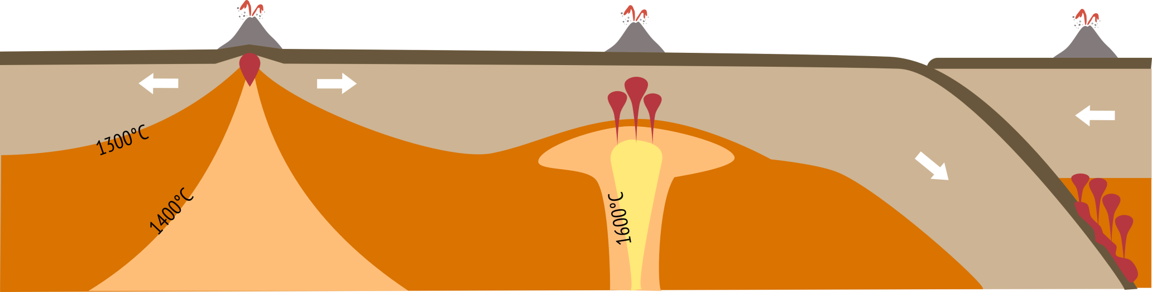

Slide 2

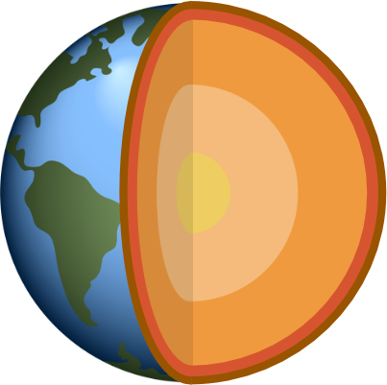
Crust
(Soild)
The interior of the Earth is hot due to decay of radioactive minerals and residual heat from Earth’s formation
Crust and mantle are solid rock not liquid
Lithosphere
Asthenosphere
Mantle
(Soild)
Outer core
(liquid)
Inner core
(soild)
Notes:
To have a volcano erupt we first need to make liquid magma but where does this come from?
The interior of the Earth is hot due to the decay of radioactive minerals and from the residual heat from the formation of the Earth and solar system (small moons and asteroids crashing together produces a lot of heat!) – because of this the Earth’s core is 5000-6000°C. Even though the core of the Earth is really hot the mantle and crust are solid rock and the Earth’s tectonic plates do not float upon a sea of molten magma (a common misconception).

Slide 3

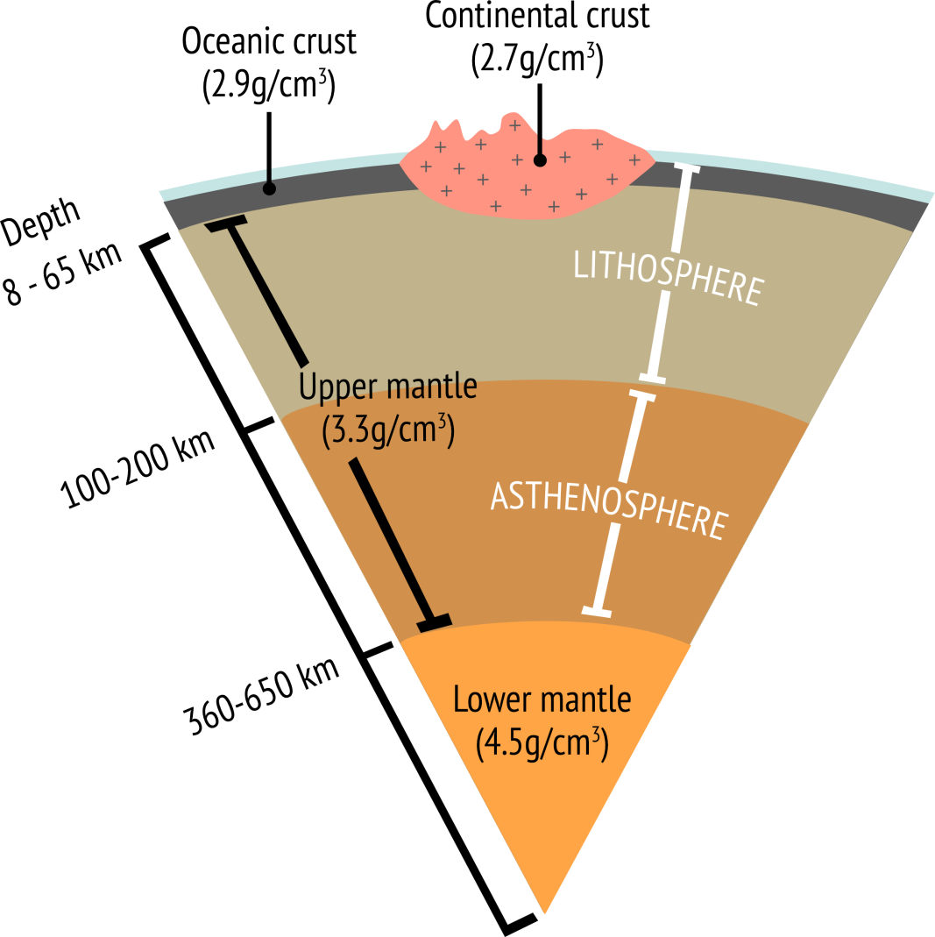
Lithosphere – the rigid outer part of the Earth made from the crust and upper parts of the mantle which mechanically acts as a single unit. The lithosphere is brittle and cannot flow.
Asthenosphere – the upper mantle below the lithosphere which is ductile and can flow plastically – but is still a solid.
Notes:
Lithosphere – the rigid outer part of the Earth made from the crust and upper parts of the mantle. Together these layers mechanically acts as a single unit. The lithosphere is brittle and cannot flow.
Asthenosphere – the upper mantle below the lithosphere. The asthenosphere is ductile and can flow plastically.
Both the asthenosphere and lithosphere are made from solid rock not liquid magma.

Slide 4

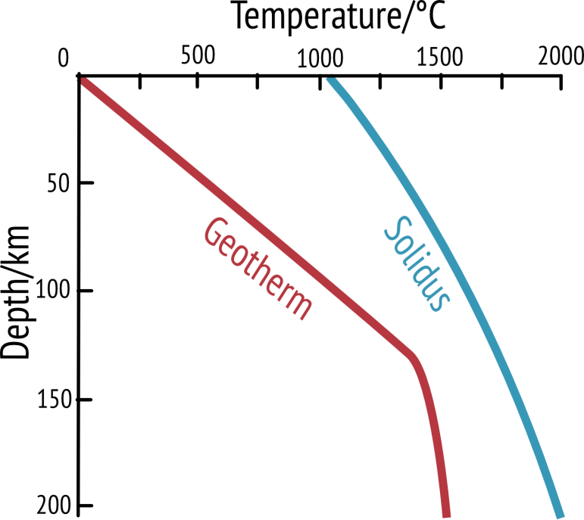

Average section of crust and mantle (i.e. away from plate boundaries)
No magma generated
Notes:
The red line on the graph is the geothermal gradient which shows the rate of increasing temperature with respect to increase with depth into the Earth’s interior. On average (i.e. away from plate boundaries) temperature increases at a rate of 25-30°C per km in the lithosphere. The kink in the geothermal gradient indicates the lithosphere-asthenosphere boundary which occurs at 1300°C.
For rocks to melt the geothermal gradient (or geotherm) must cross the solidus (blue line). The solidus marks the transition from solid mantle rock to rock that can melt and form pockets of magma. Because of pressure increases the solidus increases in temperature the further down you go. In an average section of crust and mantle the geotherm does not cross the solidus and therefore no liquid magma can be produced (the solidus is for the rock peridotite which makes up the average composition of the mantle).
There are three situations where we can get the geotherm to cross the solidus and therefore we can get melting and so we can get magma for our volcanoes.

Slide 5
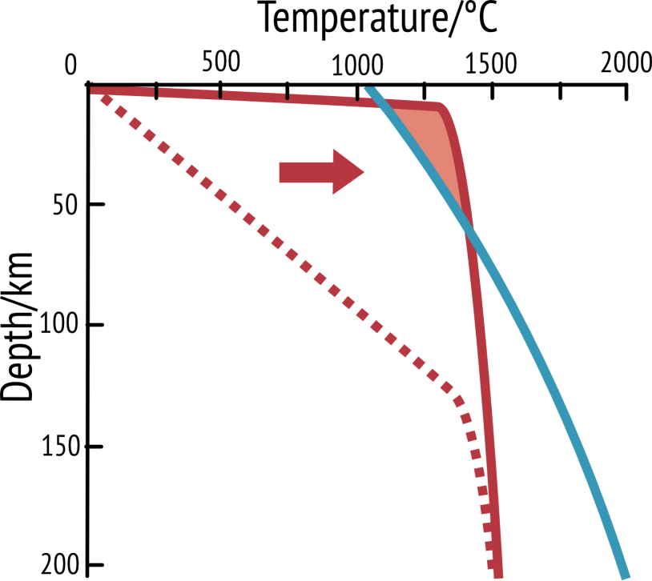
1. Mid ocean ridge
Magma generated
Notes:
This graph shows what happens at a constructive/divergent boundary – a point where two plates are moving away from each other (for example in the Mid Atlantic ridge). Because the lithosphere is thinned here, the asthenosphere (which is hotter) rises and therefore the geotherm is much shallower and crosses the solidus near the top of the graph. Therefore in this zone magma can be generated and we can get volcanoes and new basaltic ocean crust.

Slide 6

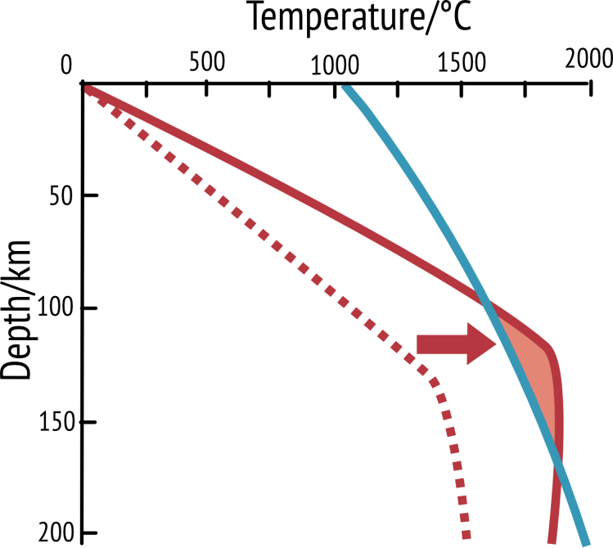
Magma generated
2. Hotspot
Notes:
This graph shows what happens when we increase the temperature of the mantle. This happens when there is a hotspot in the mantle for example under the Hawaiian Islands. Because the mantle temperature is hotter than usual, the geotherm shifts to the right and crosses the mantle solidus. Therefore we can generate molten magma.

Slide 7
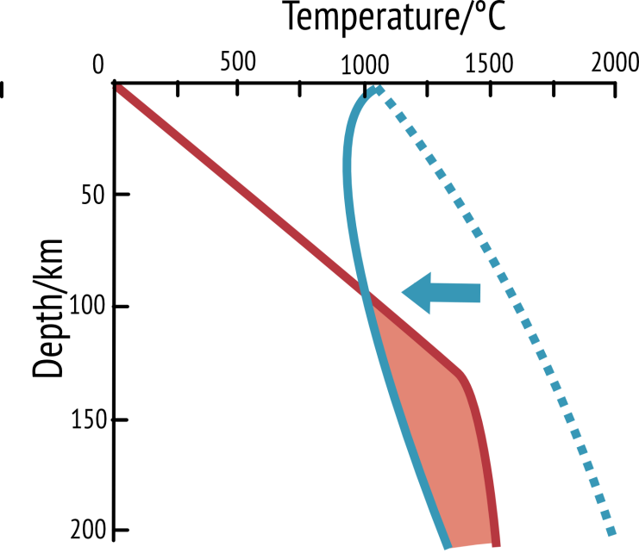
3. Subduction zone
Magma generated
Notes:
This graph shows what happens when water gets into the mantle – this is what happens at subduction zones (destructive/convergent boundaries) where one tectonic plate is thrust beneath another. Hydrated minerals in the crust heat up and release water into the mantle lowers the mantles melting point and therefore the shape of the solidus changes – hydrated mantle rocks melt at a lower temperature and whilst the geotherm has stayed the same, it now crosses over the solidus and can generate magma.

Slide 8
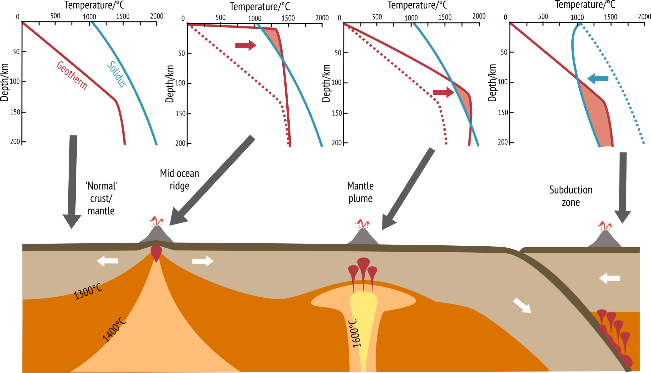
a)
b)
c)
d)

